Slide 1




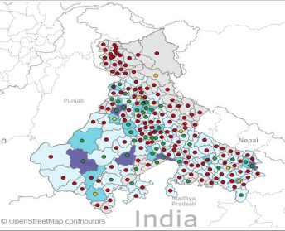
Granular growth plan for building materials – implemented across cement, pipes, wires
BASIC MATERIALS| ASIA
BAS028
Key questions
Key solutions delivered
Next step planned
Which micro-markets can unlock maximum volume/share growth ?
District level construction demand model based on cement and macro data
BoQ factors to estimate cement, pipe, wires demand
73 growth clusters
Estimate micro-market potential (within district), using AA and data-points like mobile traffic, energy consumption
How to win - differentiated GtM approach based on micro-market readiness
Differentiated GtM approach
– Core:1 Channel loyalty, pricing excellence, dealer churn
Seed : Enter the market
Growth : Over-invest to win
Core : Defend and ring-fence
Large
7
8
9
Medium
4
5
6
Growth: retail reach, range
selling, distributor capital
Seed : set-up primary channel, brand awareness
Smaller markets
Opportuni
stic Growth
Home : Sustain
1
2
3
Low share Medium share
Ability to win
(% Market share of sales by weight)
High share
How to translate plan to
execution ?
PERFORMANCE APPRAISAL- QUANTITATIVE : -
AxxOx KxxTxx
Granular district action plans (DAPs)
Align sales KRAs/KPIs to plan
SFDC enabled KRA dashboard
and tracking
Automated sales analytics engine to analyze and suggest intervention required
KRA(To be decided by the employee and
suprevisor at the beginning of Qtr)
TARGET
ACTUAL
% ACHVD
WEIGHTAGE
SCORE
Retailing Days (Field Work)
RETAILING
25 19
76
5
3.8
No. Of Visits (Total Visits) 228 133 45.18
PROMOTIONAL ACTIVITY
Mega Meets 2 1 50
Bombarding 0 3 0
NETWORK DEVELOPMENT
Retail outlet activation 0 2 0
DP Activation 0 0 0
SALES VOLUME
20
9.04
12
6
10
0
10
0
5
0
Primary Sales - V4 (Rs. In Lacs) 0 0
0
20
0
Primary Sales (Rs. In Lacs) Secondary Sales (Rs. In Lacs)
0
0
0
3.62
0
0
20
8
0
0

Slide 2
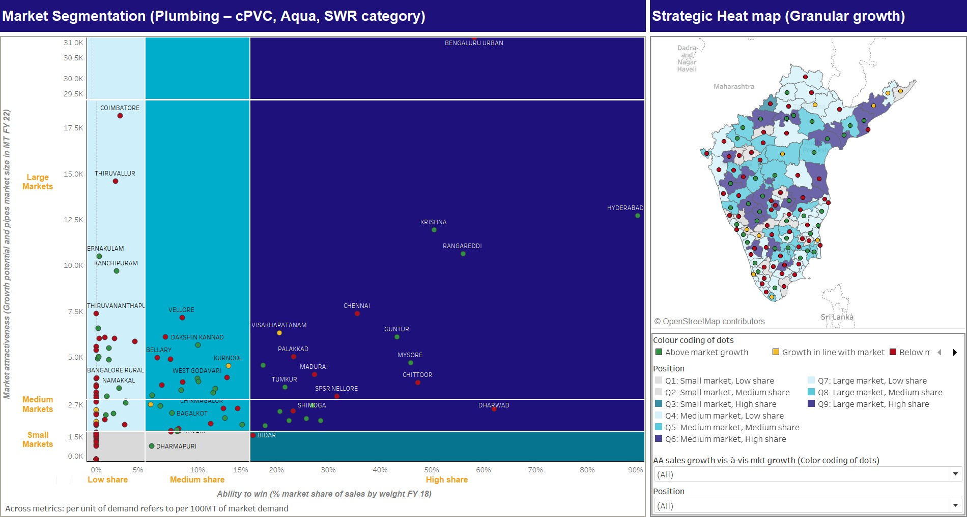
Granular growth map using Tableau
SOURCE: Team Analysis

Slide 3
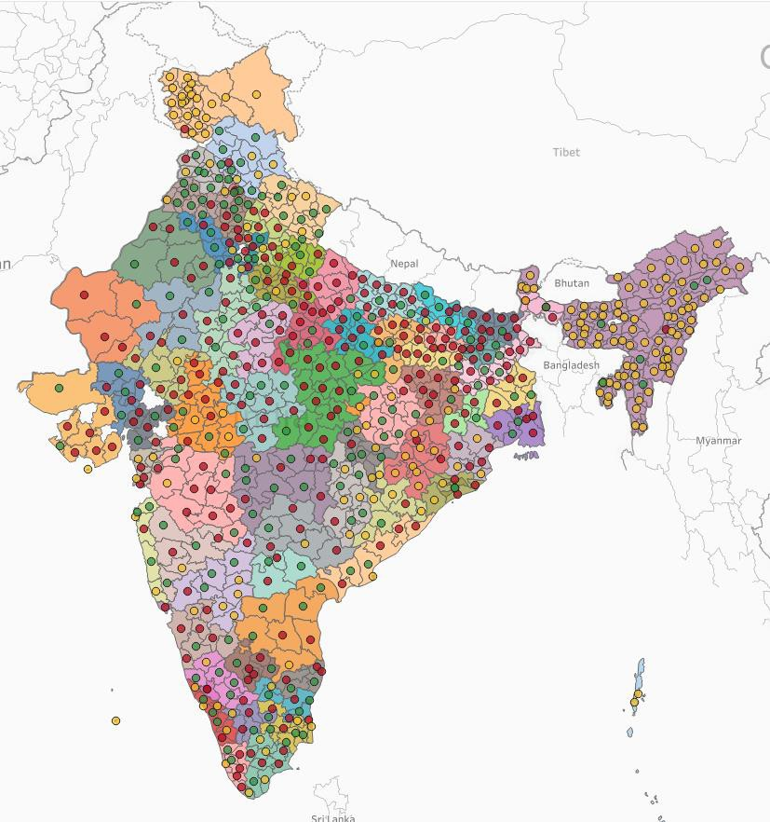

India can be viewed as 73 growth clusters, covering 658 districts
Takeaways
Each cluster functions as an independent local economic drivers and advertising channel
25% of districts (183 districts) will drive about 77 percent of India’s incremental GDP from 2012 to 2025
SOURCE: Team Analysis

Slide 4


Differentiated GtM interventions identified for Core, Grow, Seed
Seed
Prioritized manpower allocation to impact
markets
Better market understanding through surveys, field visits (competition, customer perception)
Target ‘A’ class distributors of competitors/big dealers of complementary category items
Grow : Over-invest to win
1. Select few dealers (30-40) & direct engagement with them
Core: Defend and ring-fence
1. Pareto model (Top 20% contributing 80% of sales)
Target based loyalty programs
Market attractiveness (Growth potential and market size) In MT
A
B
C
Distributors sales team to call them
“Star” dealers program
Sell full product range of AA
New product launches at dealership
Exclusivity for new product
AGM to own; Priority visits, supply and branding
Dealer club
Large
2. New dealer conversion toolkit:
Highlight new product range of AA
6 months promotional scheme to new outlets
In-shop branding
Help with early conversions
Plumber engagement + sales tracking (before v. after)
Plumber school (semi-skilled converted to skill)
Plumber clubs (family connect, accidental insurance etc)
After sales service: complaint booking with call center
Pricing for slow moving/non-moving products
Systematic incentives for range selling (portfolio scheme)
Convert irregular dealers to regular dealers
MOP to be fixed:
Upgrade to direct dealer
Special seed scheme; Plant visit
Prioritized dealer selection
Focus on getting big orders (to create word of mouth brand spread)
Demand generation team for sites
Plumber engagement at high level; create quality awareness - “Halla Bol”
Mystery shopping to create indirect/perceived
demand generation
Dealer engagement for small projects: Direct orders to dealers
Increase brand visibility across market
Connect to tile dealers/related category dealers (Target categories which have low margins)
Plumber loyalty programs and certificates (training/certified)
Medium
Bring all the dealers on the table for MOP
Set the right example for violation
End customer price to be fixed
Weekly call to plumbers (general discussion + emo connect)
Mini meets for plumbers to explain about product range
Smaller markets
D
Opportunistic Growth
Selectively invest
Ensure basic retail coverage
E
Home: Sustain
1. Smaller markets where Ashirvad is a top 3 player
Sustain with efficient coverage/local area activities
Improve or sustain price premiums/ margins
Low share
Medium share
High share
Ability to win (% Market share of sales by weight)
SOURCE: Team Analysis
4

